Slide 1
List
Def: Lists are used to store multiple items in a single variable.
List Properties:
Collection of items of different item( int,float,string)
Use [] to indicate items
Its ordered.(we cant change order of item)
It allows repeated values to be stored(duplicate)
List is mutable(after creation we can add or delete items)
How to create list
Using -- > [] or list()
student = [‘Ram’, 101,’15/02/2003’,96.56]
Student=list((‘Ram’, 101,’15/02/2003’,96.56))
Total item calculation: len(listname)

Slide 2
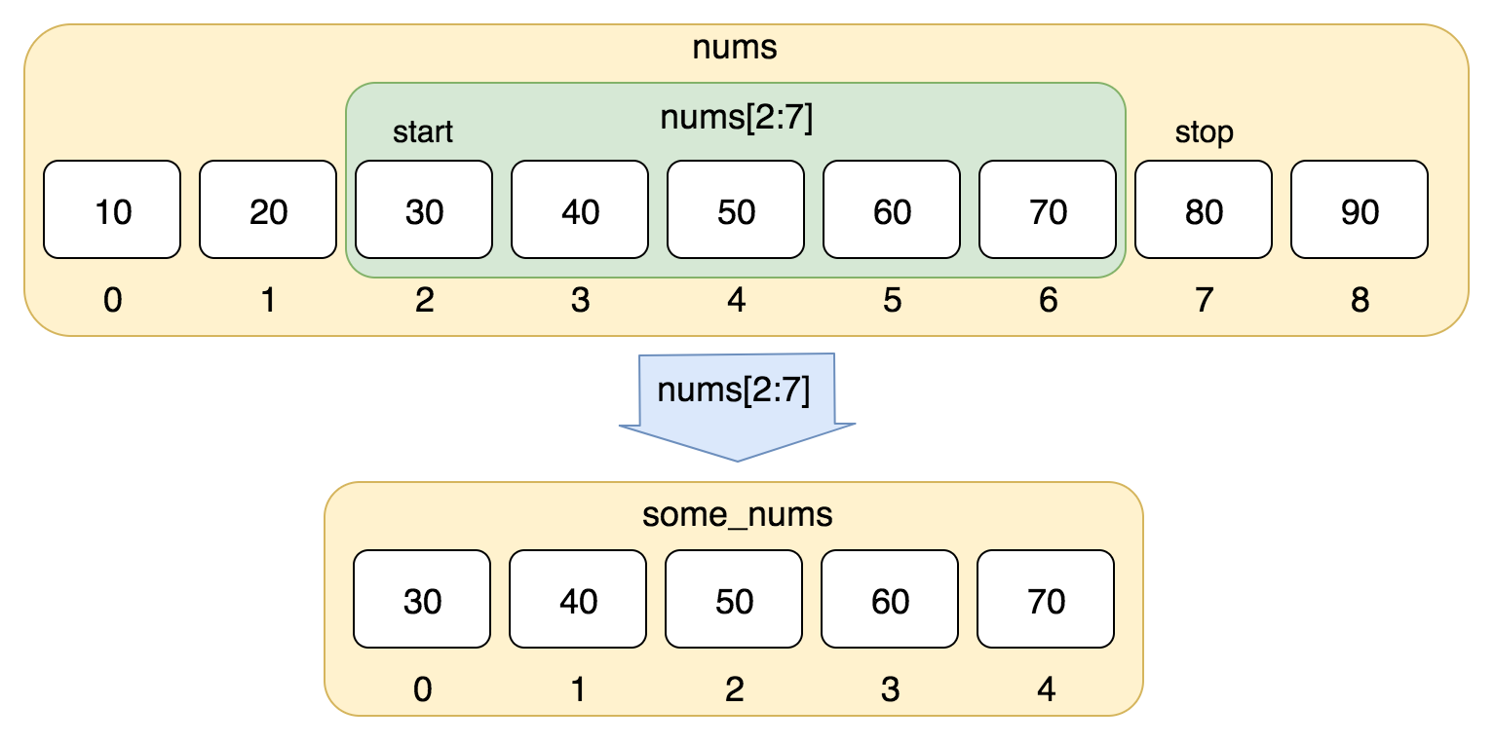
Accessing the list - > index or offset
Index
Notation is []
Positive index → starts with 0 and ends with (n-1)
Negative index -→ starts with -1 (approaches from last item)
Eg : fruits=list(('apple','banana','grapes’))
fruits=['apple','banana','grapes’]
Slicing operator (:) -> to access multiple items
nums = [10, 20, 30, 40, 50, 60, 70, 80, 90]
Eg: fruits[1:3]

Slide 3
Nested list
List contains another list
A=[1,2,[3,4,5],6]
A[0]=1, A[1]=2,a[2][0]=3,a[2][1]=4,a[2][2]=5,a[3]=6
adding item
'''fruits=list(('apple','banana','grapes'))
fruits.append('strawberry')
print("fruit List.....")
for i in range(len(fruits)):
print(fruits[i])'''

Slide 4
deleting item
fruits=list(('apple','banana','grapes','watermelon','custardapple','orange'))
print("fruit List.....")
for i in range(len(fruits)):
print(fruits[i])
del fruits[0]
fruits.remove('grapes')
fruits.pop(2)
fruits.pop()
print("fruit List after deletion.....")
for i in range(len(fruits)):
print(fruits[i])

Slide 5
nested list
a=[1,2,[3,4],[5]]
print(a[2][0])
print(a[2][1])
Built in function
Append(1)
B=fruits.copy()
fruits.count(‘apple’)
Fruits.extend([‘banana’,’cherry’]) -

Slide 6
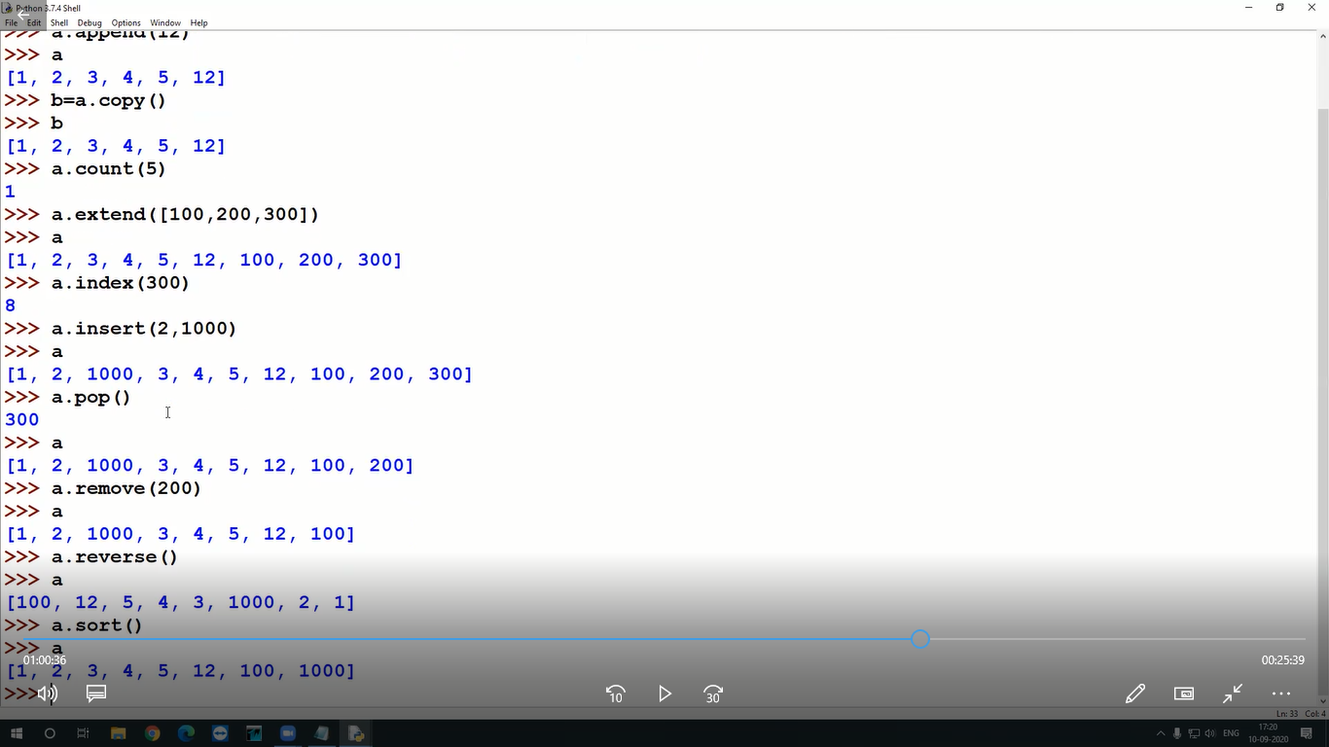

Slide 7
Tuple
A tuple is a collection which is ordered and unchangeable.
Tuple items are ordered, unchangeable, and allow duplicate values.
Tuples are unchangeable, meaning that we cannot change, add or remove items after the tuple has been created.
It can be indicated by ()
Eg:
fruits=('apple','banana','grapes','watermelon','custardapple','orange’)
t=tuple((1,2,3,4))
print("fruit List.....")
for i in t:
print(i)
for i in range(len(fruits)):
print(fruits[i])

Slide 8
Create Tuple With One Item
To create a tuple with only one item, you have to add a comma after the item, otherwise Python will not recognize it as a tuple.
fruits=('apple')
print(type(fruits))
fruits=('apple',)
print(type(fruits))
tuple with tuple() constructor
fruits=tuple(('apple',20))
for i in range(len(fruits)):
print(fruits[i])

Slide 9


https://www.sanfoundry.com/python-questions-answers-polymorphism/

Slide 10
Task:
1.Write a Python program to print a specified list after removing the 0th, 4th and 5th elements.
Sample List : ['Red', 'Green', 'White', 'Black', 'Pink', 'Yellow’]
2. Write a Python program to print the numbers of a specified list after removing even numbers from it
3. Write a Python program access the index of a list
4.Write a Python program to count the number of strings where the string length is 2 or more and the first and last character are same from a given list of strings. Sample List : ['abc', 'xyz', 'aba', '1221’]
5.Write a Python program to find the index of an item in a specified list.

Slide 11
Write a Python program to get the smallest number from a tuple.
Write a Python program to remove duplicates from a list.
Write a Python program to get unique values from a list.
Generate a Python list of all the even numbers between 4 to 30

Slide 12
1) lets take this list
a) initial list --> ["carrot","tomato","cabbage","cauliflower","tomato"]
b) insert "egg plant" into as a "3rd element"
c) add "beet root" into last
d) extend this small list ["cabbage","greenchilly","raddish"]
e) remove "cabage" and list updated list
d) check for count of tomato,cabbage
f) display the index of "beet root"
g) remove last element
h) copy this list to another list
i) sort out the list
j) make empty list

Slide 13
Generate a Python list of all the even numbers between 4 to 30
print(list( range(4, 30, 2)))

